Slide 1
BSE662A
PREDICTABLY
IRRATIONAL
END-SEM PRESENTATION

Slide 2
TABLE OF CONTENTS
01
02
03
04
05
INTRODUCTION
METHODS
RESULTS
REPLICATION
RESULTS
CONCLUSIONS
EXTENSION

Slide 3
INTRODUCTION
The "description-experience gap" occurs when people value symbolic choices more than experienced ones of the same worth.
A previous study investigated the effect of experiential value neglect and proposed potential reasons for this phenomenon.
Our extension study aims to further explore the potential reasons behind experiential value neglect, specifically examining whether higher memory retrieval costs are responsible.

Slide 4
Learning phase (LE): Shaped pairs of alternatives and partial feedback on predicted values.
Testing phase (ES): Participants choose between experiential options and symbolic pie charts with different values.
Replication experiment: 20 LE presentations of 2 pairs of experience options. ES phase shows each E option against each of 7 S choices once without feedback.
Extension experiment: Participants will learn and test again, adding a memory retrieval cost problem. The aim is to determine whether increased memory retrieval costs affect experiential option decision-making.

Slide 5
METHODS
Fitted Sigmoid curve to the data of every E-option
Used inverse of every sigmoid function to find the indifference point for every E-options
Fitted linear curve to the indifference points for LE and ES phase
We have used the python scipy library for curve fitting
JANUARY
FEBRUARY
MARCH
APRIL
MAY
JUNE
PHASE 1
Task 1
Task 2
PHASE 2
Task 1
Task 2

Slide 6
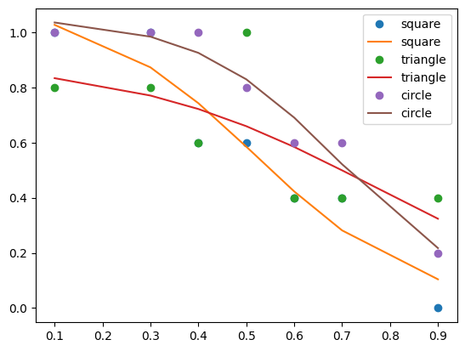
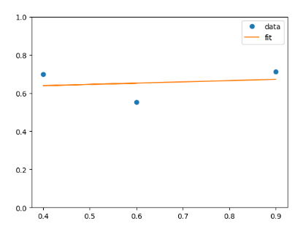
RESULTS
Replication
Resemblance seen
Sigmoid nature is visible, consistent with original data
The linear line of the indifference points indicates that experiential options underweighted.
Sigmoid curve fit for replication choice data
Linear fit of the indifference points obtained from the replication experiment

Slide 7
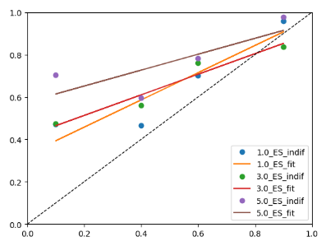
Extension
The extension was made in 3 difficulties(2, 4, 6 clicks respectively)
The final regression fit graph seems to display neglect with some bias.
Increasing the difficulty decreases the slope, while also increasing this bias.
Increased difficulty in the S options, we do notice that the slope overall is higher than that of the replication experiment
Some evidence to our hypothesis of experiential value neglect happening partially(or wholly) due to computational cost difference.
Linear fit of indifference points obtained for the 3 difficulty levels

Slide 8
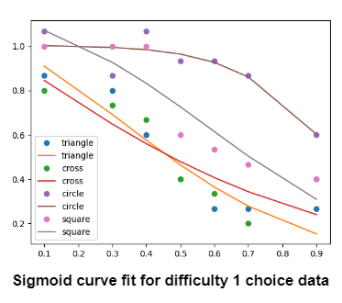
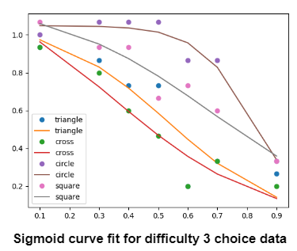
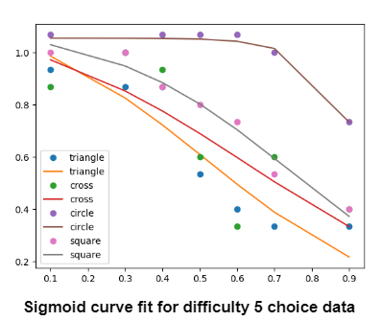
SIGMOID FIT

Slide 9
CONCLUSIONS
Some noisy evidence of experiential value neglect in the replication experiment
Some evidence of reduction in experiential neglect in the extension experiment
Imperative that more data is required for forming better conclusions
T-tests have to be performed to validate hypotheses
Other possible extension experiments could be performed

